Slide 1
Design for Verification Project Update
2021-11-04
Eldrick Millares (eldrick@stanford.edu)

Slide 2
Recap - OOO Processor Deployment Progress
Investigating possible over-constraint of CVA6 due to very little effort needed to eliminate counterexamples
Using Ridecore example to inform CVA6 constraints

Slide 3
Investigating Over-Constraints
Specified incorrect reset signal to be tied to de-assert - was driving top level reset
Top level reset was unconnected to true reset signal to design!
Undriven nets are assigned to 1’b0, therefore processor was held in reset due to active low reset line.

Slide 4
Outcome: Counterexamples!
Now investigating counterexample related to symbolic initialization of scoreboard
Currently testing with NOP instructions being issued only from QED module, so all counterexamples must come from symbolic initialization

Slide 5
Outcome: Counterexamples!
In previous simple designs (VScale, Steelcore), a counter that counts to the length of the pipeline depth sufficed to mark when all SIF instructions commit
This worked because after counting NUM_STAGES cycles, all SIF instructions would be flushed
However in OOO designs, SIF instructions can emit from a scoreboard or ROB, which prevents this simple form of tracking

Slide 6
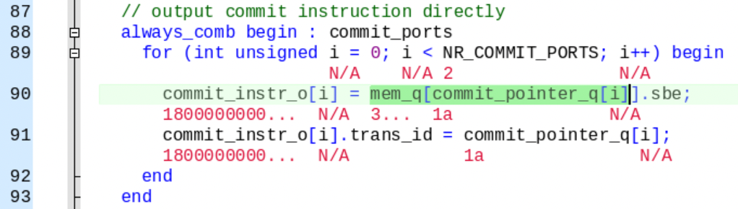
Outcome: Counterexamples!
Example: Commit stage instruction below is being assigned a value from mem_q, which is symbolically initialized and has 8 entries

Slide 7
Solving Scoreboard Spurious Counterexample
Solution 1: Wait longer for SIF commit… (until scoreboard flushes)
Pro: Simple
Con: Affects proof radius (? in practice, this does not seem to be the case)
Solution 2: Constrain initialization of scoreboard
Pro: No longer affects proof radius
Con: Limits the set of initial states

Slide 8
Solving Scoreboard Spurious Counterexample
Chose solution 1
Waiting 16 cycles in total after symbolic initialization to check properties
Currently debugging counterexample traces...

Slide 9
Solving Scoreboard Spurious Counterexample
Chose solution 1
Waiting 16 cycles in total after symbolic initialization to check properties
Currently debugging counterexample traces - assertions fires in cycle 18...

Slide 10
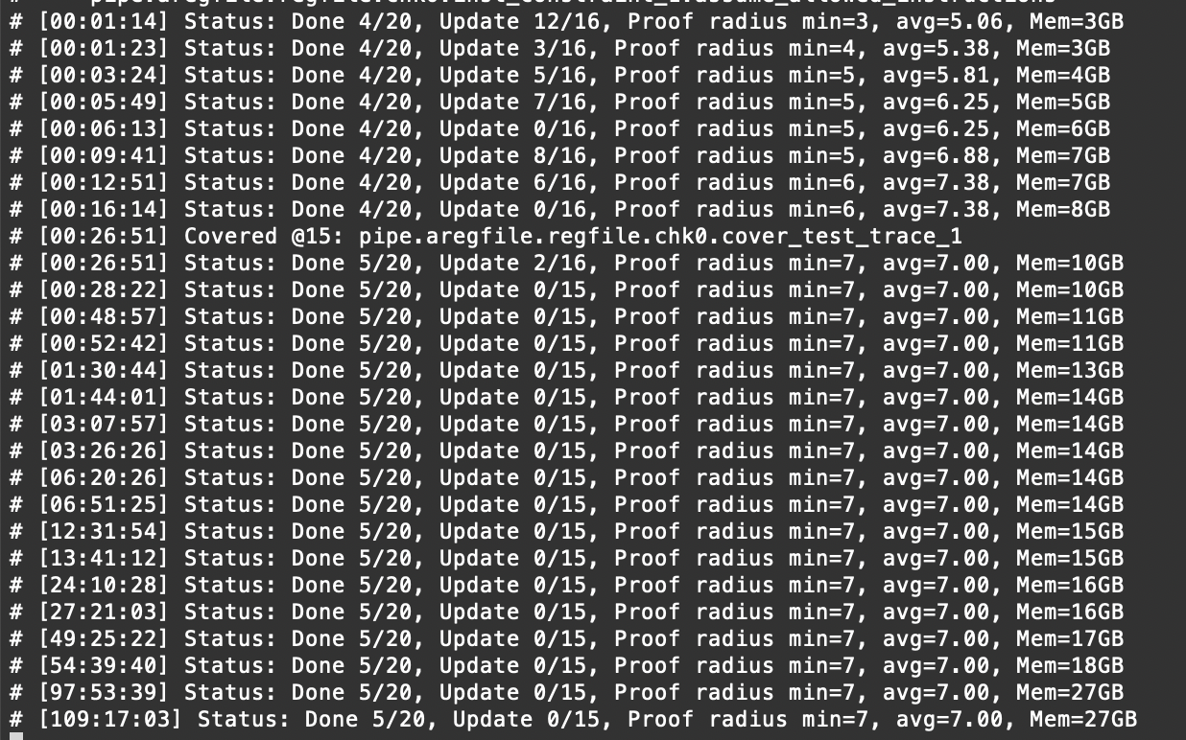
Solving Scoreboard Spurious Counterexample

Slide 11
Investigating Ridecore
Last time, was getting counterexamples in RIDECORE example
Was found among many ridecore examples with Ishan’s help - no canonical example was provided
Had to remove an inserted trojan
Dual issue but 2nd instruction issue signal was left undriven - driven to NOP for now

Slide 12
Investigating Ridecore
Am using this design as a guide on how to modify / constrain CVA6 design but there are multiple edits and unexplained constraints in the design
Am in process of distilling the changes performed on this design

Slide 13
Investigating Ridecore
No counterexamples after 100 hours, but proof radius is small (7 cycles)
No change in proof radius after 100 hours

Slide 14
Investigating Ridecore
Need to debug why the tool chokes up on this design
What was the final status of this design? Paper draft suggests deploying proof was successful but cannot find the canonical artifact

Slide 15
CVA6 Deployment - Back to Step 3
Step 1: Instantiate simplified system with core + memory
Step 2: Add QED module, commit tracking logic, and current set of DFV constraints to core
Step 3: Iterate and constrain uarch blocks (RV32I Only)
Step 4: Iterate and constrain 64b instructions, M/A/C ISA Extensions

Slide 16
Next Steps:
Step 3: Iterate and constrain uarch blocks (RV32I Only)
E.g. scoreboard
Summarize changes on RIDECORE demo by diffing with original design
Debug proof bound stall on RIDECORE
Continue helping Yu-Neng & Charles in their project

Slide 17
Yu-Neng & Charles - Progress Update
Have started deploying technique to PicoRV32
Spent past week familiarizing themselves with previous demos, RISC-V ISA, and PicoRV32 design specifics
Are now in process of wiring up the SQED module and launching their first runs

